Slide 1
Physics Laboratory 2 – Experiment 6a: Heating pump
Lukas Prader¹,Andrija Đokić², Kemal Önen³
Advisor: Dr. Fabio Zappa
Date of experimental execution: 04.05.2023
Date of presentation: xx.05.2023
¹ lukas.prader@student.uibk.ac.at
² andrija.djokic@student.uibk.ac.at
³ kemal.oenen@student.uibk.ac.at

Slide 2
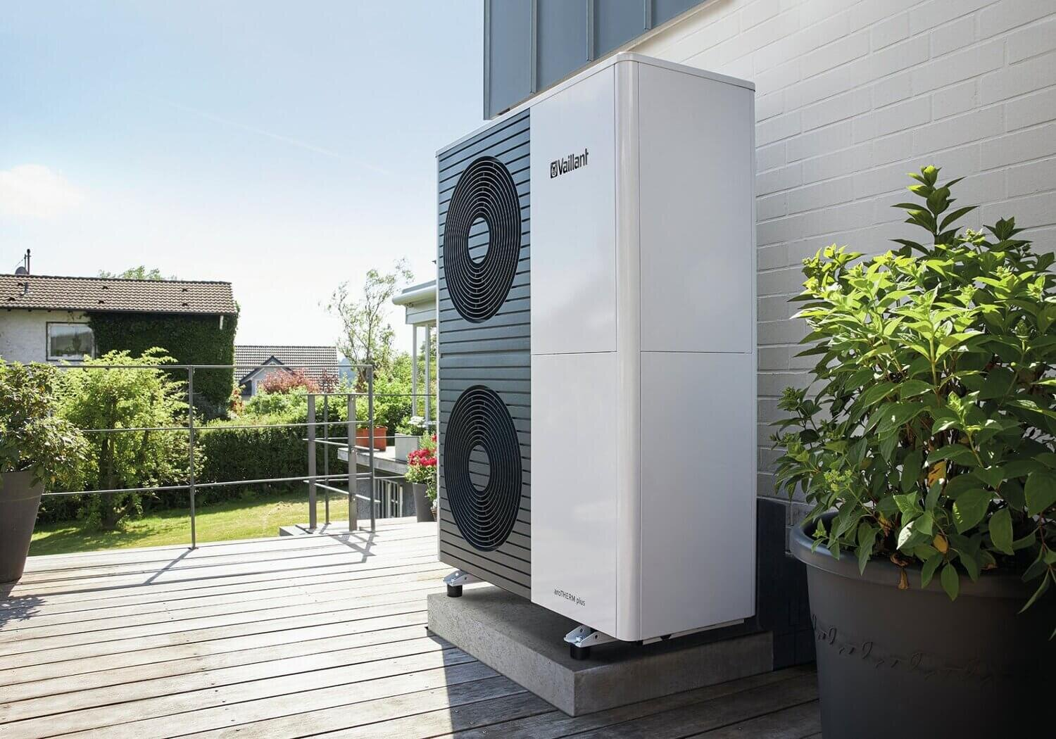
Overview
Everyday use: Fridge, Air conditioner, heat pump for heating
Source: https://www.snuggenergy.com/blog/heat-pumps-the-snugg-energy-2023-guide

Slide 3
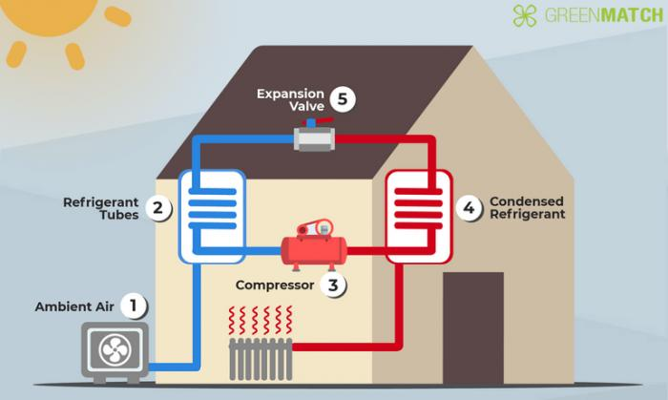
Overview
Everyday use: Fridge, Air conditioner, heat pump for heating
Very efficient, they practically “steal” the heat of the other medium
Therefore high efficiency quotient
Relationship between used and output energies
Normally around 4, at best around 6
Means with 1kW electricity we get 4kW heat
Source: https://www.rateitgreen.com/green-building-articles/heat-pumps-energy-efficient-and-cost-effective-heating-cooling-solutions/133

Slide 4
Theoretical background
4 most important laws of thermodynamics
0. Law: Concept of temperature
1. Law: Inner energy in connection with work/warmth
2. Law: Natural warmth transport from objects with higher temperatures to those with smaller → concept of entropy
3. Law: Absolute zero temperature is outside reach

Slide 5
Theory – Entropy and Enthalpy
Concept of entropy S
Logarithmical mass of the statistical weight for most probable macrostate of the system
Dependent of volume and inner energy ↔ definitions of all thermodynamical sizes
Stays same for reversible processes, increases for irreversible ones
Concept of enthalpy H
Easier to follow and manipulate with
Contains information of relevant inner energy and energy needed for a certain volume under a given pressure
Chemical reactions, Phase transitions: ∆H is absorbed/emitted energy

Slide 6
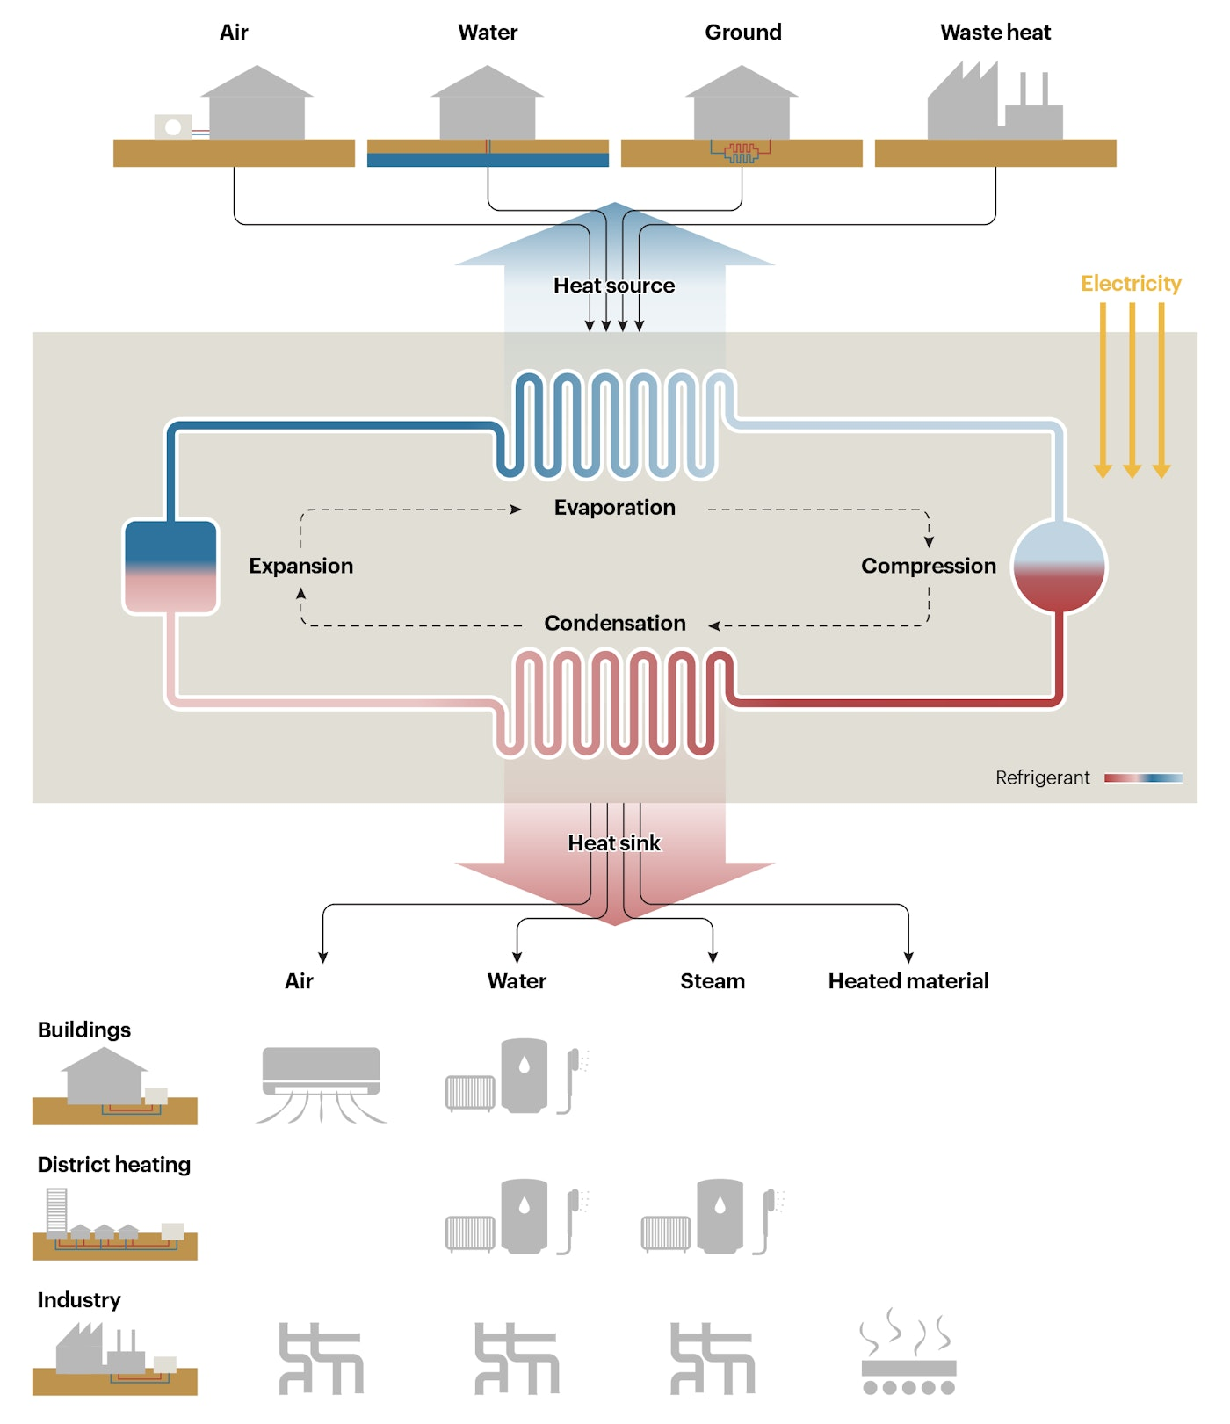
Theory – Phase transitions
Nowadays nearly all heat pumps use transition between gas and fluid
Why? → Great energy in phase transitions
Example: Water with c=2260kJ/kg, Freon R134a: c=200kJ/kg
Image source: https://www.iea.org/reports/the-future-of-heat-pumps/how-a-heat-pump-works

Slide 7
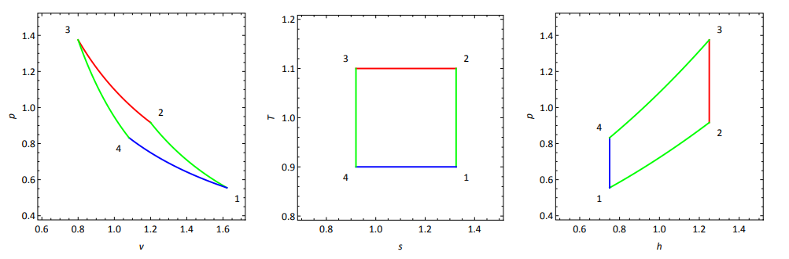
Theory – Carnot cyclus
Image source: Skriptum GP2-V06a_Waermepumpe
Isentropic compression (1→2): Freon heats up to T of warm reservoir
Isothermic warmth emission (2→3): degradation of Entropy of Freon
Isentropic expansion (3→4): Freon cools down to T of cold reservoir
Isothermic warmth absorption (4→1): increase of Entropy of Freon

Slide 8
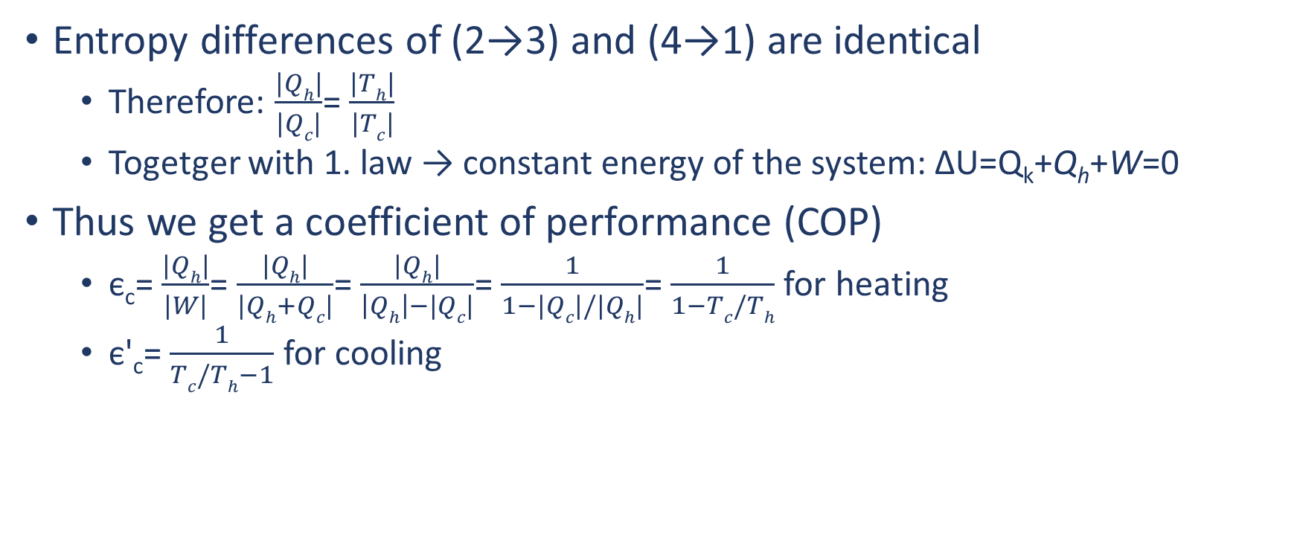
Theory – Carnot cyclus cont.
Entropy differences of (2→3) and (4→1) are identical
Therefore: $\frac{|Qh|}{|Qc|}$= $\frac{|Th|}{|Tc|}$
Togetger with 1. law → constant energy of the system: ∆U=Q_{k}+Q_{h}+W=0
Thus we get a coefficient of performance (COP)
є_{c}= $\frac{|Qh|}{|W|}$= $\frac{|Qh|}{|Qh+Qc|}$= $\frac{|Qh|}{\left|Qh\right|−|Qc|}$= $\frac{1}{1−|Qc|/|Qh|}$= $\frac{1}{1−Tc/Th}$ for heating
є'_{c}= $\frac{1}{Tc/Th−1}$ for cooling

Slide 9
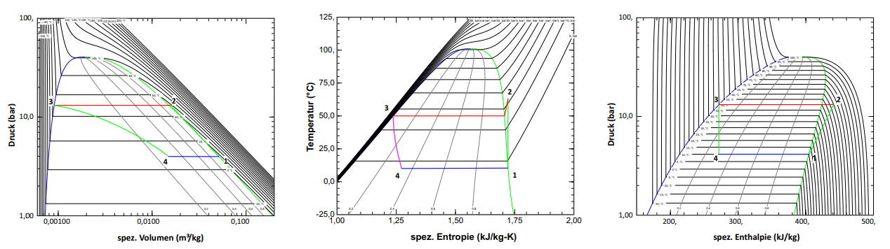
Theory – Clausius-Rankine cyclus
Isentrophic compression (1→2): idealy all work to enthalpie
Isobaric warmth emission (2→3): Freon heats up the warm reservoir
Isenthalpic expansion (3→4): through throttle valve
Isobaric warmth absorption (4→1): Freon takes warmth from cold res.

Slide 10
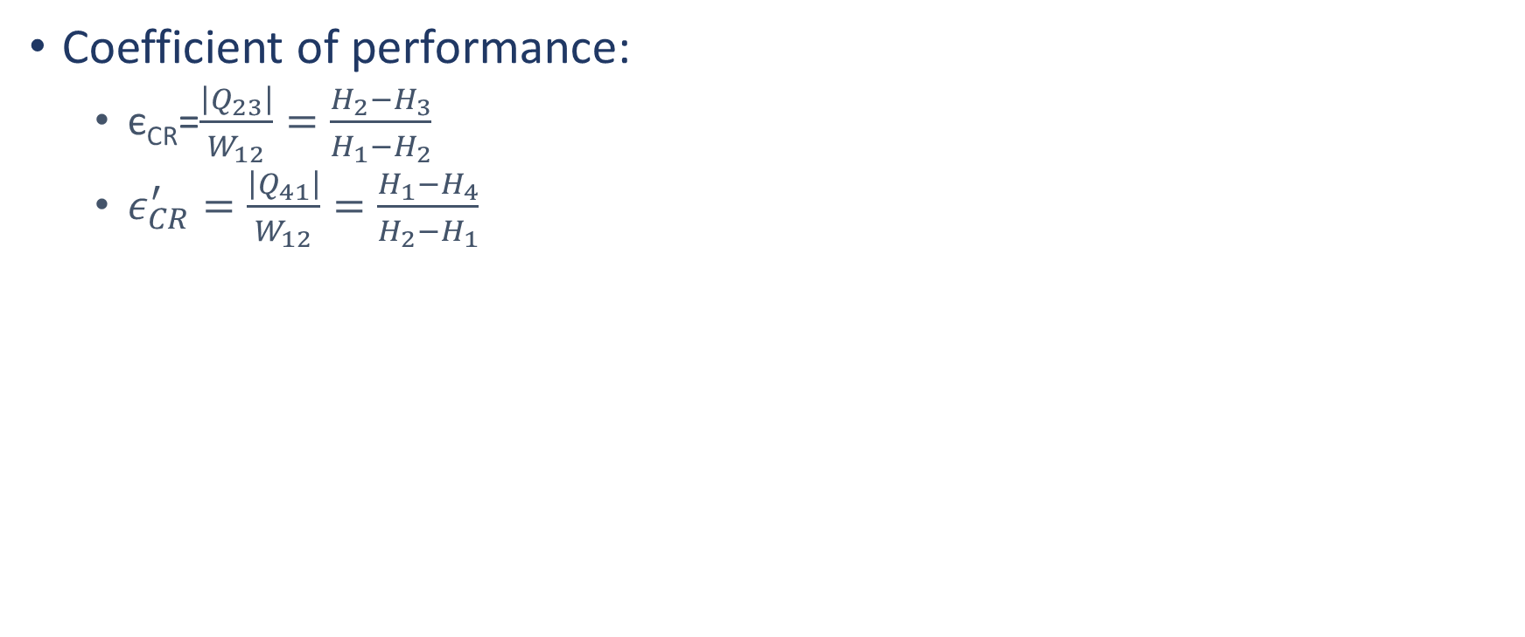
Theory – Clausius-Rankine cyclus cont.
Coefficient of performance:
є_{CR}=$\frac{\left|Q_{23}\right|}{W_{12}}=\frac{H_{2}−H_{3}}{H_{1}−H_{2}}$
$ε_{CR}^{′}=\frac{\left|Q_{41}\right|}{W_{12}}=\frac{H_{1}−H_{4}}{H_{2}−H_{1}}$

Slide 11
Motivation
Goals:

Slide 12
Experimental setup

Slide 13
Results

Slide 14
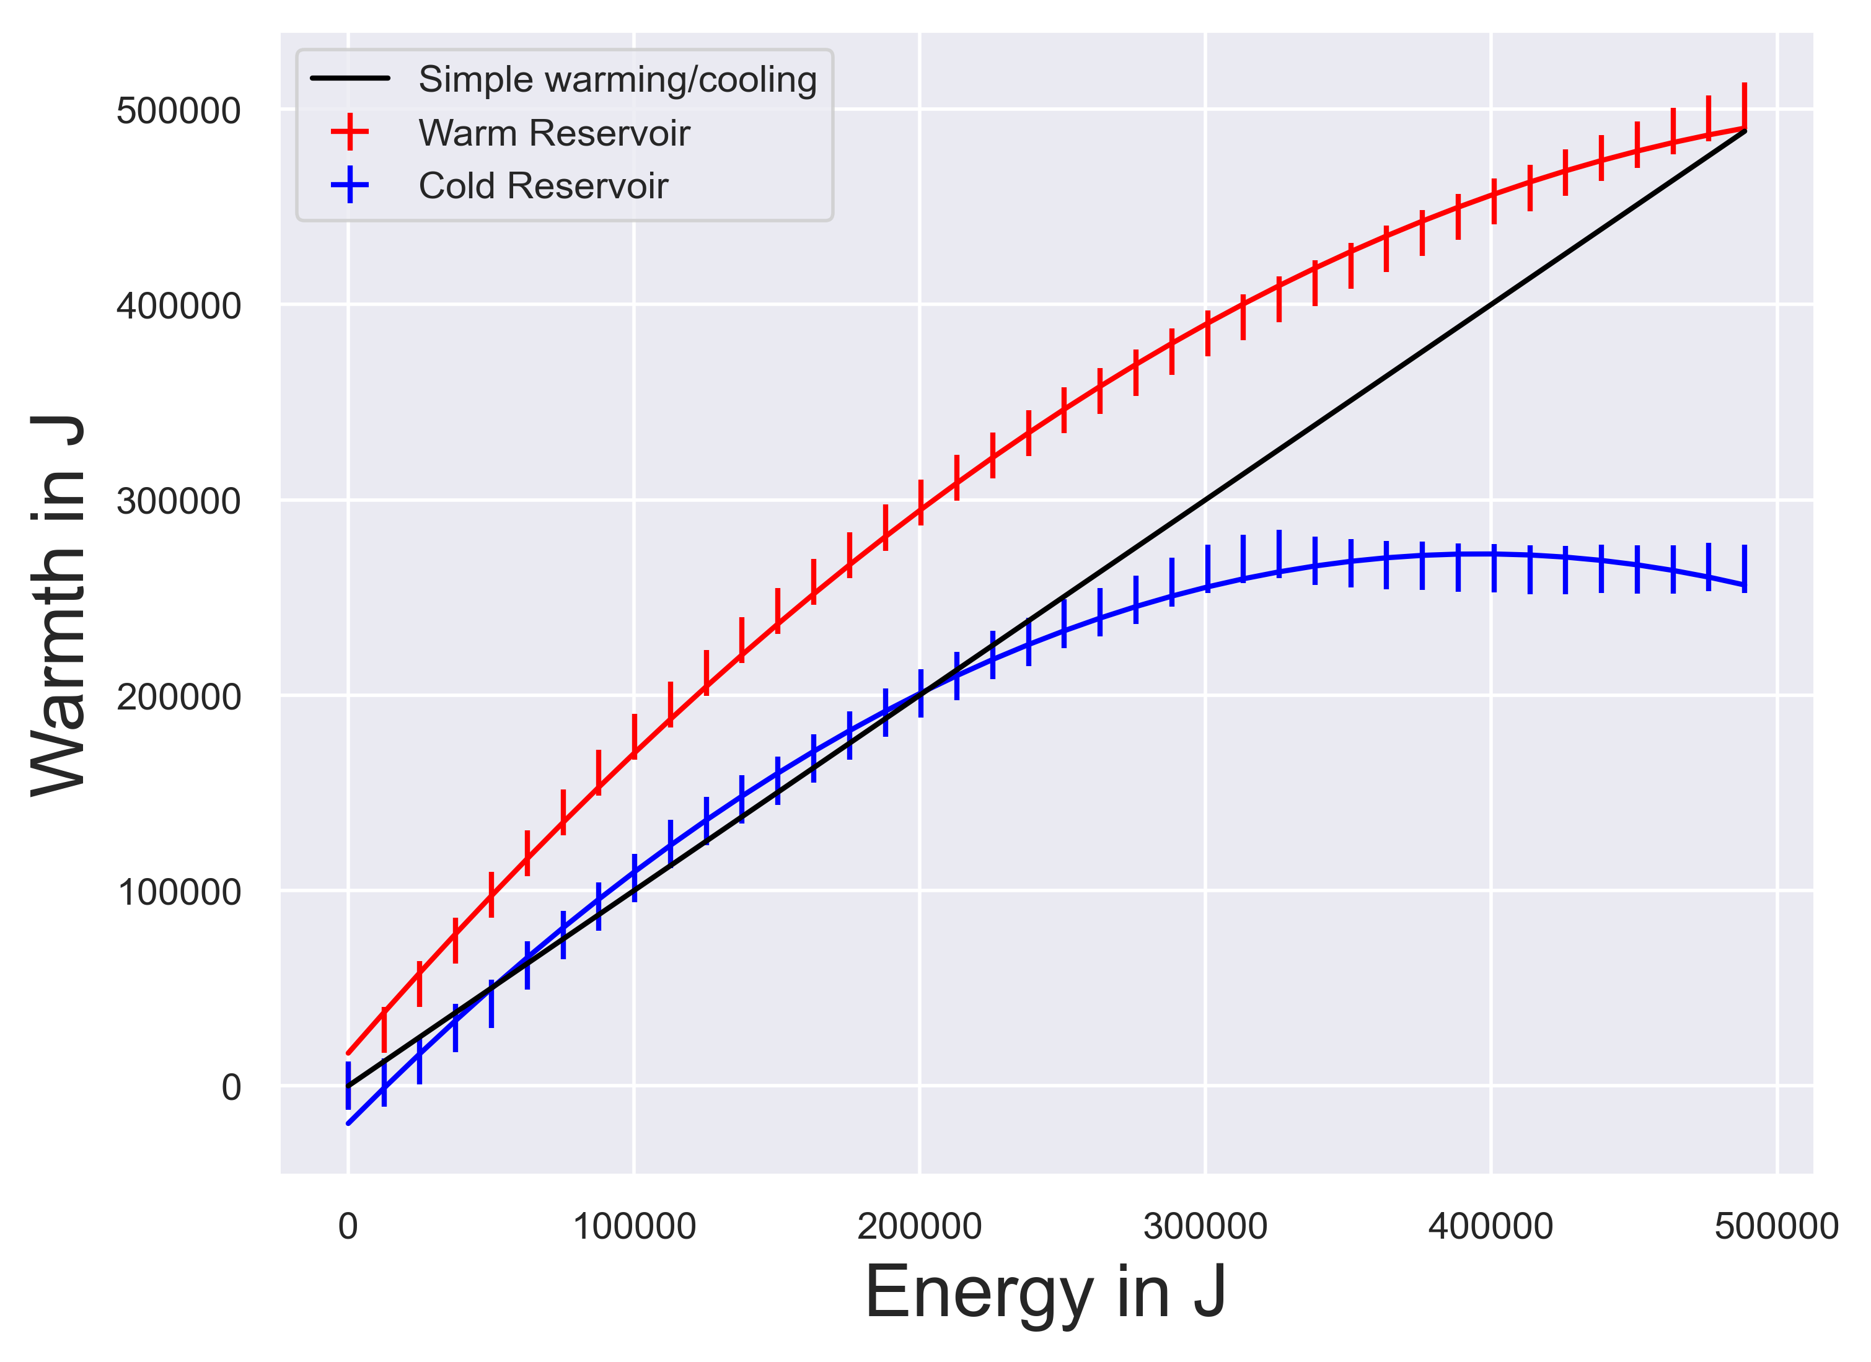
Plot of energies
Absolute values of cooling, thus a positive incline
Values fitted with a polynomial of 2nd Grade
From there we can approximate the COP at certain points

